Slide 1

G14 Hospital Database Management System
Faculty: Applied and Computer Sciences
Department: Computer Sciences
Subject: Information System 1.2
Subject Code: AIITY1A
Lecturer: Ms. N. Moyo
Group: 14
Assessment 3: Project Plan

Slide 2
Group 14
1
Lefalahae Modjadji
2
Siyabonga Nkosi
3
Navelo Harvey Maluleke
4
Oratile Tyamzashe
5
Hlulani Maluleke
6
Tamiah Vitomi Mawila
7
Mikateko Mhlarhi
8
Agreement Sambo
9
Nolwazi Mchunu
10
Kgothatso Mathe

Slide 3
Agenda
1
The Scenario and Introduction
2
The Solution
3
Business Rules
4
Database Normalization
5
ERD Phase
6
SQL Code
7
SQL Query Results
8
Conclusion

Slide 4
The Scenario
1
2
3
4
A patient arrives at G14 Healthcare Facility in Vanderbijlpark, requiring medical attention
The patient's medical record must be located before care can proceed
Physical files and manual record-keeping make finding the correct file slow
Other patients keep arriving, queues grow and staff face increasing pressure
The challenge
How records are kept
Delays in retrieving medical records can affect the patient experience and make it difficult for healthcare workers to access important information when they need it.
Patient information, appointments, treatments, prescriptions and billing details are stored in physical documents and separate files.

Slide 5
Introduction
Who we serve
G14 Healthcare Facility provides basic healthcare services to the Vanderbijlpark community.
What operations rely on
Accurate and accessible information for patient care, appointment scheduling, treatment management, prescription records, billing and staff administration.
The challenge
The existing flat-file system is becoming less suitable as the patient population grows. It relies heavily on manual processes, making information difficult to retrieve, update and maintain consistently.

Slide 6






Introduction: Key Problems Identified
Slow information retrieval
Poor record storage
Data duplication
Staff must manually search through physical files, delaying access to patient information.
Paper documents occupy significant space and can be lost, damaged or misplaced.
The same patient information may be recorded in appointment, treatment, prescription and billing files.
Difficult information updates
Data integrity and security concerns
Inefficient reporting
Changes to patient details may need to be made across several files, creating opportunities for human error.
Complete, accurate and protected records are harder to maintain when information is scattered.
Compiling reports and analysing operations is challenging when information is in separate files.

Slide 7
The Solution
Structured, related tables
Replace G14's existing flat-file system with a relational database management system
Information is organised into related tables rather than scattered across separate physical files.
Primary and foreign keys
Keys establish relationships between the different types of records.
Group 14 proposes a structured database solution designed around G14's information management needs.
Linked, not duplicated
A patient's information links to appointments, treatments and prescriptions without repeating details in every record.

Slide 8
The Solution: How It Works
Proposed tables
Database normalisation
Patients, doctors, appointments, treatments, prescriptions, bills and staff members. Each table stores information relevant to its purpose.
Progressing from Unnormalized Form (UNF) through 1NF and 2NF to 3NF reduces data duplication, improves consistency and maintains data integrity.
Security and backup
Expected outcome
Appropriate access controls, security measures and backup procedures protect sensitive patient information from loss or unauthorised access.
Reduced administrative burden, better record organisation and better access to patient information. The database cannot independently guarantee shorter waiting times or better clinical outcomes.

Slide 9
Business Rules
The rules describe how G14 Healthcare Facility operates and how data is managed within the proposed relational database, supporting day-to-day hospital operations.
Patient
Staff
Appointment
Admission
Ward
BR1 to BR5
BR6 to BR11
BR12 to BR19
BR20 to BR26
BR27 to BR30
Room
Treatment
Medicine
Prescription
Billing
BR31 to BR39
BR40 to BR46
BR47 to BR52
BR53 to BR60
BR61 to BR65

Slide 10
Patient and Staff Rules
Patient Rules
Staff Rules
BR1 Each patient is identified by a PatientID
BR2 A patient can have one or more appointments
BR3 Each appointment has exactly one patient
BR4 A patient can have one or more billing records
BR5 A patient can be in the system without an appointment
BR6 Every staff member has their own StaffID
BR7 Every staff member has a StaffType: Doctor, Nurse, Receptionist or Administrator
BR9 A staff member can be in multiple treatments
BR10 Only Doctors and Nurses can be assigned to treatments
BR11 Receptionists and Administrators cannot give or supervise treatments

Slide 11
Appointment and Admission Rules
Appointment Rules
Admission Rules
BR12 Each appointment has a unique AppointmentID
BR13 Each appointment has one patient assigned
BR15 The patient must be in the system before an appointment is created
BR17 An appointment can yield 0 or 1 admissions
BR18 Zero, one or many prescriptions per appointment
BR19 Appointment status is recorded
BR20 Each admission has a unique AdmissionID
BR21 Every admission comes from one appointment
BR22 Each admission is given a room
BR24 No admission without an appointment and room
BR25 Admission and discharge dates are documented
BR26 A patient can have several admissions over time

Slide 12
Ward and Room Rules
Ward Rules
Room Rules
BR27 Every ward has a WardID
BR28 A ward can have one or more rooms
BR29 Each room is assigned to only one ward
BR31 Every room has a RoomID
BR33 A room can serve several admissions over time
BR34 One patient per room at a given time
BR36 RoomAvailability is Available or Occupied
BR37 Patients can only be put in an Available room
BR38 On admission the room becomes Occupied
BR39 On discharge the room becomes Available

Slide 13
Treatment and Medicine Rules
Treatment Rules
Medicine Rules
BR40 Each treatment has a unique TreatmentID
BR41 All treatments belong to an appointment
BR42 Each treatment is carried out or supervised by one staff member
BR43 One or more treatments per appointment
BR44 Diagnosis and treatment description are recorded
BR46 Treatment can be for an outpatient or an admitted patient
BR47 Each medicine has a unique MedicineID
BR48 Every medicine has a MedicineName
BR49 Every medicine has a stock value
BR50 A medicine can be on several prescriptions
BR51 A medicine can exist without a prescription
BR52 Stock is adjusted when medication is supplied

Slide 14
Prescription and Billing Rules
Prescription Rules
Billing Rules
BR53 Each prescription has a unique PrescriptionID
BR54 Each prescription is linked to an appointment
BR55 Every prescription includes one medicine
BR58 Multiple prescriptions can be issued for one appointment
BR60 Dosage is recorded for each prescription
BR61 Each bill has a unique BillID
BR62 Each bill belongs to one patient
BR63 A patient may have multiple billing records
BR64 PaymentStatus is Paid, Pending or Overdue
BR65 Bills reflect services provided in appointments, admissions, treatments and prescriptions

Slide 15
Relationship and Cardinality Summary
One | Can have | Related records
Patient | many | Appointments
Patient | many | Billing records
Appointment | many | Treatments
Appointment | many | Prescriptions
Appointment | zero or one | Admission
Ward | several | Rooms
Room | many, over time | Admissions
Staff member | many | Treatments
Medicine | several | Prescriptions

Slide 16
Database Normalization: Introduction
Normalization converts the existing flat-file system into a structured relational database
The flat file combines patient, staff, treatment, room and billing data, causing duplicated records, inefficient retrieval and update challenges
Performed step by step to reduce duplication, ensure data integrity and meet G14's operational requirements
UNF
1NF
2NF
3NF
Unnormalized Form to First to Second to Third Normal Form

Slide 17
Unnormalized Form (UNF)
PatientID | PatientName | AppointmentID | TreatmentID | PrescriptionID | MedicineName | WardName | BillAmount
P001 | John Smith | A001 | T001 | PR001 | Amlodipine | General | 1500
P001 | John Smith | A001 | T002 | PR002 | Aspirin | General | 1500
P002 | Mary Jones | A002 | T003 | PR003 | Paracetamol | Surgical | 2200
P003 | David Brown | A003 | T004 | PR004 | Metformin | ICU | 1800
Problems Identified
Patient information is repeated
Appointment information is repeated
Medicine information is repeated
Billing information appears multiple times
Data redundancy exists throughout the table
Updating, deleting or inserting data may cause anomalies

Slide 18
First Normal Form (1NF)
Patient
Admission
PatientID | FirstName | LastName | PhoneNumber
P001 | John | Smith | 0823456789
P002 | Mary | Jones | 0834567890
P003 | David | Brown | 0845678901
AdmissionID | AppointmentID | PatientID | RoomID | Admitted | Discharged
AD001 | A001 | P001 | R01 | 01/04/2026 | 05/04/2026
AD002 | A002 | P002 | R02 | 03/04/2026 | 07/04/2026
Appointment
1NF rule
AppointmentID | PatientID | Date | Time | Status
A001 | P001 | 01/04/2026 | 08:00 | Completed
A002 | P002 | 03/04/2026 | 09:30 | Completed
A003 | P003 | 05/04/2026 | 10:00 | Completed
All repeating groups are removed and each attribute is restricted to a single atomic value per entry.

Slide 19
1NF: Treatment, Medicine, Prescription
Treatment
Prescription
TreatmentID | AppointmentID | StaffID | Diagnosis
T001 | A001 | S001 | Hypertension
T002 | A001 | S002 | Monitoring
T003 | A002 | S003 | Influenza
PrescriptionID | AppointmentID | MedicineID | Dosage
PR001 | A001 | M001 | 5mg Daily
PR002 | A001 | M002 | 100mg Daily
PR003 | A002 | M003 | 500mg Every 6 Hours
Medicine
MedicineID | MedicineName | Stock
M001 | Amlodipine | 150
M002 | Aspirin | 300
M003 | Paracetamol | 500
After 1NF
Repeating groups were eliminated
Atomic values were enforced
Each row became uniquely identifiable
Data became easier to manage

Slide 20
Second Normal Form (2NF)
All non-key attributes depend on the primary key.
Staff
Ward
StaffID | StaffType | Initials | PhoneNumber
S001 | Doctor | JM | 1236547890
S002 | Nurse | PN | 0174852369
S003 | Doctor | LK | 0321458796
WardID | WardName
W01 | General
W02 | Surgical
W03 | ICU
Billing
Room
BillID | PatientID | Amount | PaymentStatus
B001 | P001 | 1500 | Paid
B002 | P002 | 2200 | Pending
B003 | P003 | 1800 | Paid
RoomID | WardID | WardName | RoomNumber | RoomAvailability
R01 | W01 | General | 101 | Occupied
R02 | W02 | Surgical | 201 | Occupied
R03 | W01 | General | 102 | Occupied
R04 | W03 | ICU | 301 | Occupied
R05 | W02 | Surgical | 202 | Occupied

Slide 21
Second Normal Form (2NF): Improvements
After 2NF
A problem still exists in the Room table
Partial dependencies were removed
Data was separated into subject-specific entities
Medicine information was no longer duplicated
Prescription management improved
Data redundancy was significantly reduced
WardName depends on WardID rather than RoomID. This transitive dependency violates 3NF.
This takes us to the next step: Third Normal Form.

Slide 22
Third Normal Form (3NF)
All transitive dependencies are removed.
Room
We achieve the following because of 3NF
RoomID | WardID | RoomNumber | RoomAvailability
R01 | W01 | 101 | Occupied
R02 | W02 | 201 | Occupied
R03 | W01 | 102 | Occupied
R04 | W03 | 301 | Occupied
R05 | W02 | 202 | Occupied
Repeating groups are eliminated
Partial dependencies are removed
Transitive dependencies are removed
Medicine data is separated from prescription data
Appointment information is stored once
Foreign keys link related tables
Data integrity is improved
Redundancy is minimized throughout the database
Transitive dependency removed
WardName now lives only in the Ward table, so the Room table achieves 3NF.

Slide 23
Final 3NF Relations
Entities | Attributes
Patient | PatientID (PK), FirstName, LastName, PhoneNumber
Appointment | AppointmentID (PK), PatientID (FK), AppointmentDate, AppointmentTime, AppointmentStatus
Admission | AdmissionID (PK), AppointmentID (FK), PatientID (FK), RoomID (FK), AdmissionDate, DischargeDate
Ward | WardID (PK), WardName
Room | RoomID (PK), WardID (FK), RoomNumber, RoomAvailability
Staff | StaffID (PK), StaffType, Initials
Treatment | TreatmentID (PK), AppointmentID (FK), StaffID (FK), Diagnosis, TreatmentDescription
Medicine | MedicineID (PK), MedicineName, Stock
Prescription | PrescriptionID (PK), AppointmentID (FK), MedicineID (FK), Dosage
Billing | BillID (PK), PatientID (FK), Amount, PaymentStatus

Slide 24
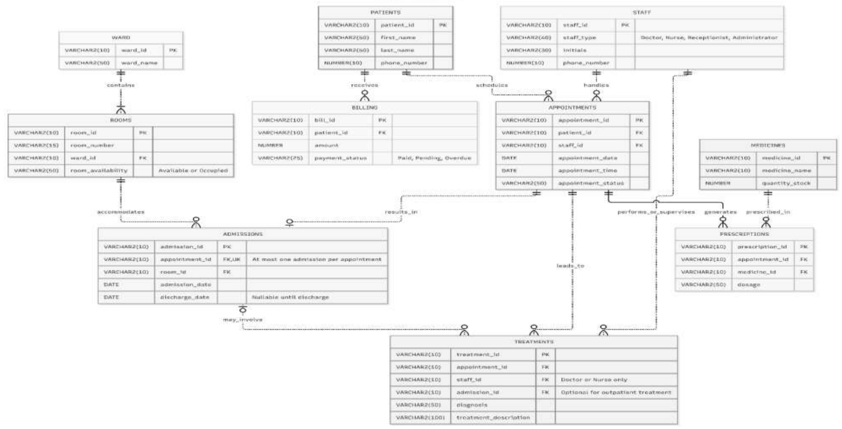
The Resulting ERD

Slide 25
Database Normalization: Summary
UNF
1NF
2NF
3NF
Normalization eliminated redundant data, improved consistency and ensured efficient data storage
The final structure manages patients, appointments, admissions, wards, rooms, staff, treatments, medicines, prescriptions and billing
It supports both outpatient and inpatient healthcare services
Next step
With the G14 database normalized, we can move to implementation or testing of the physical database.

Slide 26
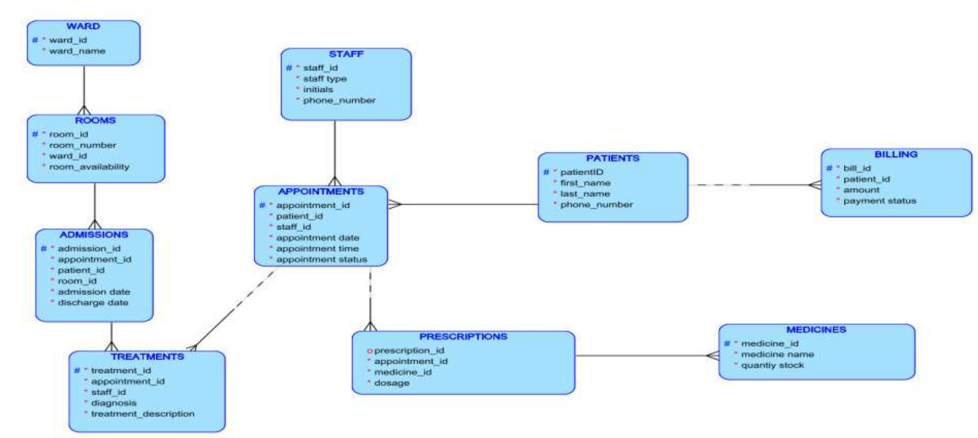
ERD Phase: Planning and Crafting
Logical: we used Oracle Data Modeler to design the initial ERDs, both logical and relational.

Slide 27
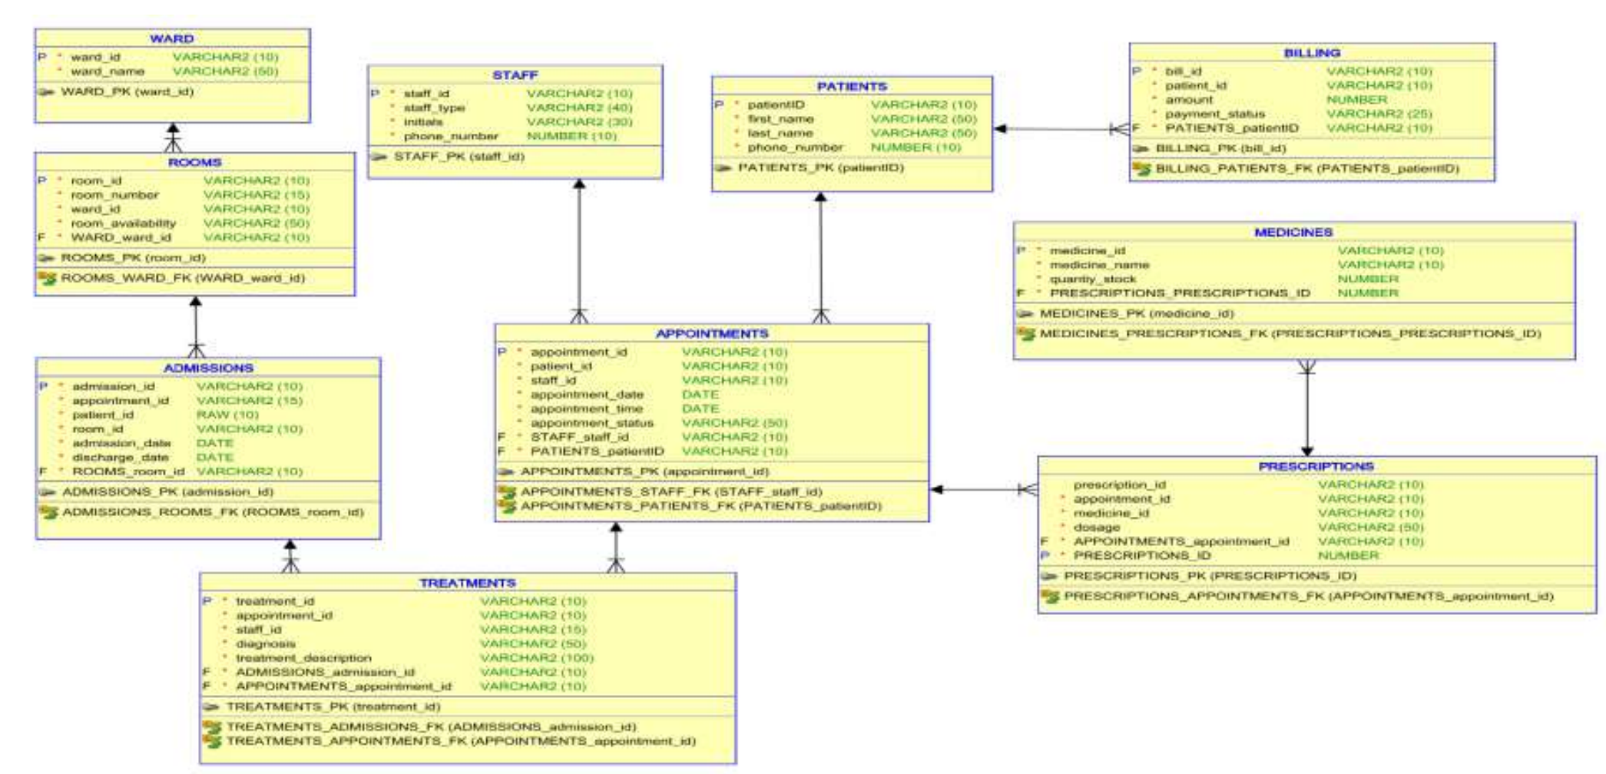
ERD Phase: Relational

Slide 28
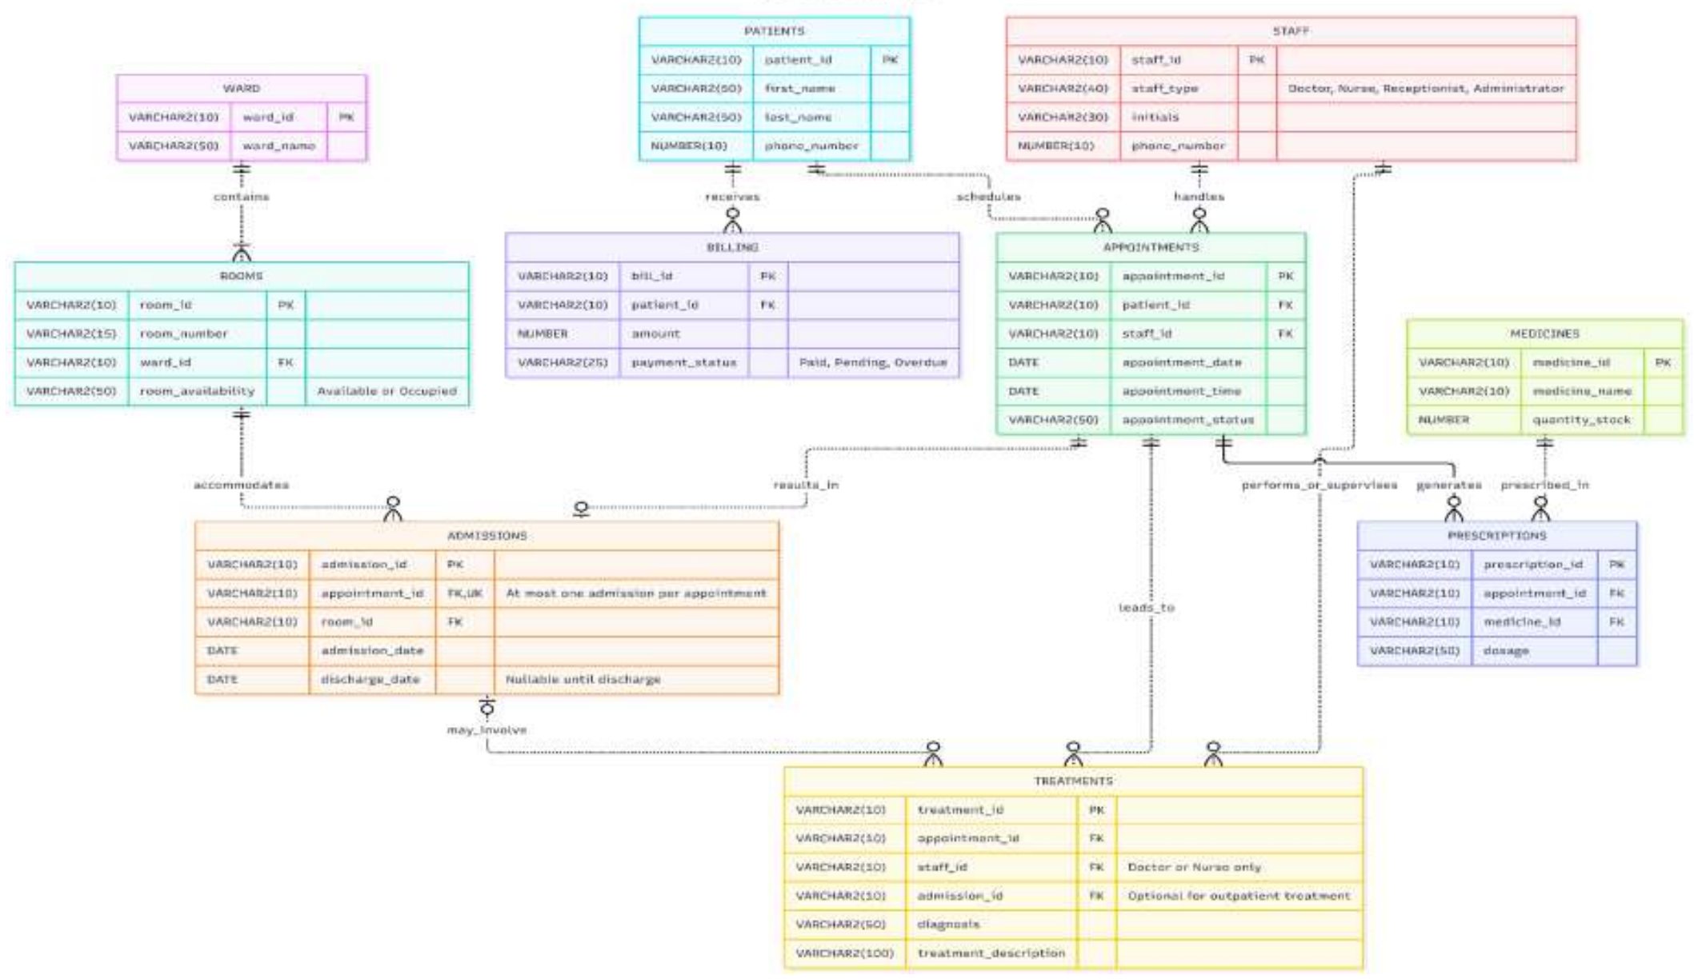
Final ERD (with crow's foot notation)

Slide 29
SQL Code: To Create the Tables
Tables, in creation order
Example: PATIENTS
PATIENTS
STAFF
CREATE TABLE PATIENTS (
patient_id VARCHAR(10) NOT NULL,
first_name VARCHAR(50) NOT NULL,
last_name VARCHAR(50) NOT NULL,
phone_number VARCHAR(10) NOT NULL,
CONSTRAINT PATIENTS_PK
PRIMARY KEY (patient_id)
);
WARD
ROOMS
APPOINTMENTS
ADMISSIONS
TREATMENTS
MEDICINES
PRESCRIPTIONS
BILLING

Slide 30
SQL Code: Keys and Check Constraints
ROOMS: foreign key and status check
Check constraints
CREATE TABLE ROOMS (
room_id VARCHAR(10) NOT NULL,
room_number VARCHAR(15) NOT NULL,
ward_id VARCHAR(10) NOT NULL,
room_availability VARCHAR(50) NOT NULL,
CONSTRAINT ROOMS_PK PRIMARY KEY (room_id),
CONSTRAINT ROOMS_WARD_FK
FOREIGN KEY (ward_id)
REFERENCES WARD (ward_id),
CONSTRAINT ROOM_STATUS_CHK CHECK (
room_availability IN
('Available','Occupied'))
);
ALTER TABLE STAFF
ADD CONSTRAINT STAFF_TYPE_CHK
CHECK (staff_type IN
('Doctor','Nurse',
'Receptionist','Administrator'));
ALTER TABLE BILLING
ADD CONSTRAINT PAYMENT_STATUS_CHK
CHECK (payment_status IN
('Paid','Pending','Overdue'));

Slide 31
SQL Code: To Insert Values into Tables
Sample statements
Sample data loaded
Table | Rows
PATIENTS | 9
WARD | 3
ROOMS | 5
APPOINTMENTS | 8
ADMISSIONS | 3
MEDICINES | 8
PRESCRIPTIONS | 6
BILLING | 8
INSERT INTO PATIENTS
VALUES ('P001','JOHN','DOE','0720017896');
INSERT INTO WARD VALUES ('W01','General');
INSERT INTO ROOMS
VALUES ('R01','101','W01','Occupied');
INSERT INTO APPOINTMENTS
VALUES ('A001','P001',
TO_DATE('01-04-2026','DD-MM-YYYY'),
'08:00','Completed');

Slide 32
Total Number of Registered Patients
SQL
Output (Oracle Live SQL)
TOTAL_PATIENTS
9
SELECT COUNT(*) AS total_patients
FROM PATIENTS;

Slide 33
Available Rooms
SQL
Output (Oracle Live SQL)
ROOM_ID | ROOM_NUMBER
R03 | 102
R05 | 202
SELECT room_id, room_number
FROM ROOMS
WHERE room_availability = 'Available';

Slide 34
Patients Currently Admitted
SQL
Output (Oracle Live SQL)
PATIENT_ID | FIRST_NAME | LAST_NAME | ROOM_ID
P001 | JOHN | DOE | R01
P002 | JANE | DOE | R02
P005 | WILL | FOSTER | R04
SELECT p.patient_id,
p.first_name,
p.last_name,
a.room_id
FROM PATIENTS p
JOIN ADMISSIONS a
ON p.patient_id = a.patient_id;

Slide 35
Number of Admissions per Ward
SQL
Output (Oracle Live SQL)
WARD_NAME | TOTAL_ADMISSIONS
General | 1
Surgical | 1
ICU | 1
SELECT w.ward_name,
COUNT(a.admission_id) total_admissions
FROM WARD w
JOIN ROOMS r ON w.ward_id = r.ward_id
JOIN ADMISSIONS a
ON r.room_id = a.room_id
GROUP BY w.ward_name;

Slide 36
Treatments Performed by Each Staff Member
SQL
Output (Oracle Live SQL)
STAFF_ID | INITIALS | TREATMENTS_DONE
SD001 | DR N NAIDOO | 2
SN002 | MN.SMITH | 0
SR001 | L.HOLLY | 0
SD002 | DR.L.SMITH | 0
SA001 | N.MOKOENA | 0
SN001 | L.MAHLANGU | 0
SN003 | G.OLESENG | 0
SA002 | K.NAUME | 0
SELECT s.staff_id,
s.initials,
COUNT(t.treatment_id) treatments_done
FROM STAFF s
LEFT JOIN TREATMENTS t
ON s.staff_id = t.staff_id
GROUP BY s.staff_id, s.initials;

Slide 37
Most Prescribed Medicine
SQL
Output (Oracle Live SQL)
MEDICINE_NAME | TIMES_PRESCRIBED
Aspirin | 2
Amoxicillin | 1
Metformin | 1
Amlodipine | 1
Paracetamol | 1
SELECT m.medicine_name,
COUNT(*) times_prescribed
FROM MEDICINES m
JOIN PRESCRIPTIONS p
ON m.medicine_id = p.medicine_id
GROUP BY m.medicine_name
ORDER BY times_prescribed DESC;

Slide 38
Medicines with Low Stock (stock under 100)
SQL
Output (Oracle Live SQL)
MEDICINE_ID | MEDICINE_NAME | STOCK
M006 | Panado | 50
M007 | Grandpa | 10
M008 | Benelin | 80
SELECT medicine_id,
medicine_name,
stock
FROM MEDICINES
WHERE stock < 100;

Slide 39
Total Revenue Generated
SQL
Output (Oracle Live SQL)
TOTAL_REVENUE
6500
SELECT SUM(amount) AS total_revenue
FROM BILLING
WHERE payment_status = 'Paid';

Slide 40
Overdue Bills
SQL
Output (Oracle Live SQL)
BILL_ID | PATIENT_ID | AMOUNT | PAYMENT_STATUS
B007 | P008 | 1250 | Overdue
SELECT *
FROM BILLING
WHERE payment_status = 'Overdue';

Slide 41
Grouping Appointments by Status
SQL
Output (Oracle Live SQL)
APPOINTMENT_STATUS | TOTAL
Completed | 5
Scheduled | 2
Cancelled | 1
SELECT appointment_status,
COUNT(*) total
FROM APPOINTMENTS
GROUP BY appointment_status;

Slide 42
Conclusion
The problem
The solution
The result
Manual flat-file record keeping caused data duplication, slow data retrieval, poor organisation and data integrity problems.
A relational database designed in Third Normal Form (3NF), modelled with an ERD and implemented in SQL.
Sample queries produced meaningful reports: registered patients, room availability, admissions, treatments, medicine stock, billing and revenue.

Slide 43
Conclusion: What G14 Gains
The database offers G14 Healthcare Facility a robust system for handling healthcare records in a unified, secure and efficient way.
Improved data integrity
Minimized data redundancy
Quick access to information and reporting
Smoother administrative processes
A foundation for future expansion
Support for both outpatient and inpatient services

Slide 44
Thank you
Questions?
Group 14 | G14 Hospital Database Management System

